Slide 1
Data Structures & Algorithm Analysis
Basic Data Structure Analysis

Slide 2
Arrays
Basic Data Structure Analysis

Slide 3
The array structure
Primary features
Fixed length data structure
Index-based access
char[] characters = new Char[8];
A | B | C | D
0 | 1 | 2 | 3 | 4 | 5 | 6 | 7

Slide 4
Linear search
Given an array and search value, return true if the array contains the search value, otherwise return false
Method signature
public boolean linearSearch(int[] array, int search)
Steps
Loop over the input array
Compare the search value against the current element
Primitives: use the == operator
Objects: use the equals() method
9 | 17 | 3 | -10 | 9 | 11 | 33 | 2
0 | 1 | 2 | 3 | 4 | 5 | 6 | 7

Slide 5
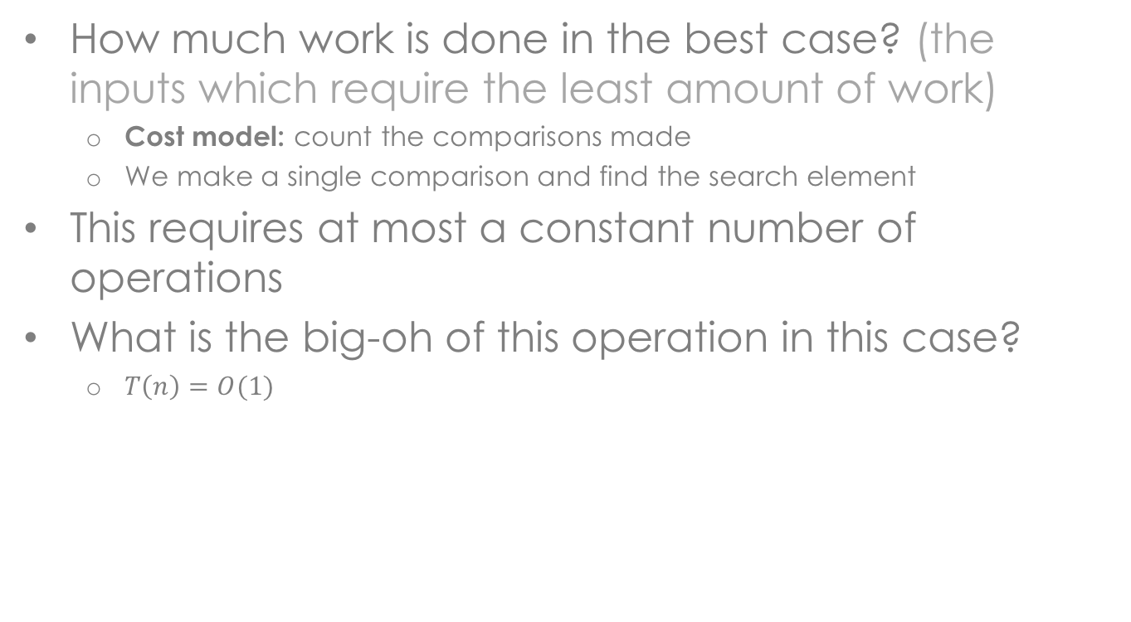
Best case?
How much work is done in the best case? (the inputs which require the least amount of work)
Cost model: count the comparisons made
We make a single comparison and find the search element
This requires at most a constant number of operations
What is the big-oh of this operation in this case?
$T\left(n\right)=O(1)$
9 | 17 | 3 | -10 | 9 | 11 | 33 | 2
0 | 1 | 2 | 3 | 4 | 5 | 6 | 7

Slide 6
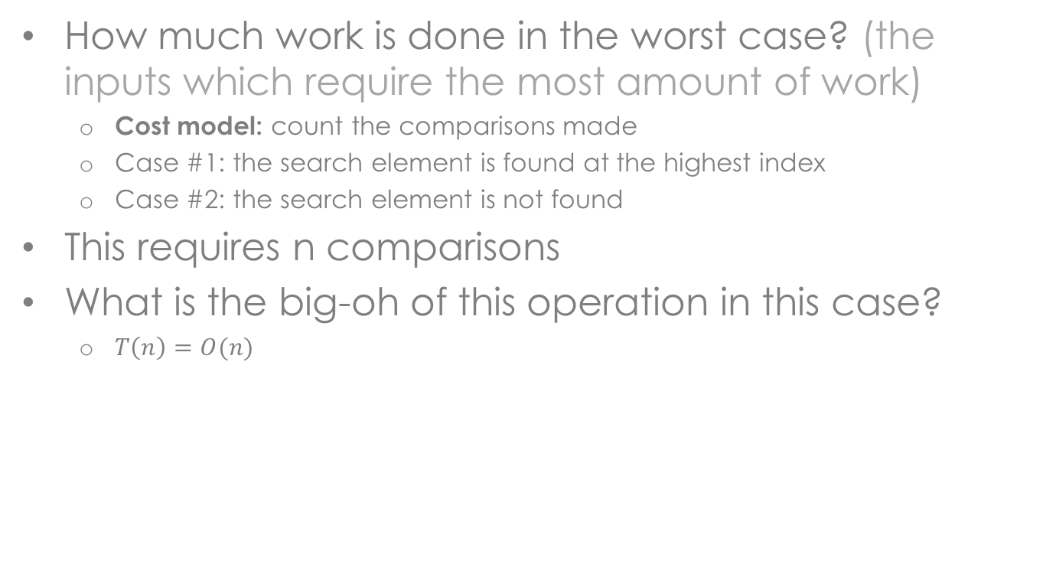
Worst case?
How much work is done in the worst case? (the inputs which require the most amount of work)
Cost model: count the comparisons made
Case #1: the search element is found at the highest index
Case #2: the search element is not found
This requires n comparisons
What is the big-oh of this operation in this case?
$T\left(n\right)=O(n)$
9 | 17 | 3 | -10 | 9 | 11 | 33 | 2
0 | 1 | 2 | 3 | 4 | 5 | 6 | 7

Slide 7
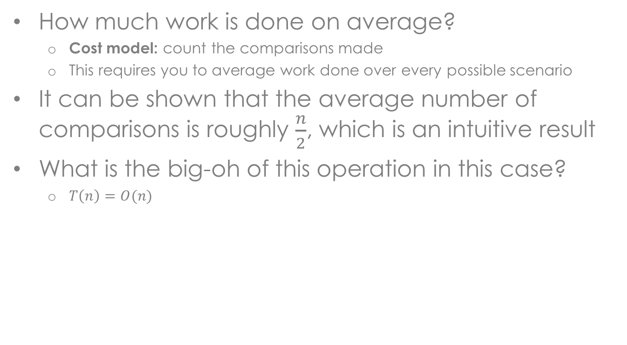
Average case?
How much work is done on average?
Cost model: count the comparisons made
This requires you to average work done over every possible scenario
It can be shown that the average number of comparisons is roughly $\frac{n}{2}$, which is an intuitive result
What is the big-oh of this operation in this case?
$T\left(n\right)=O(n)$
9 | 17 | 3 | -10 | 9 | 11 | 33 | 2
0 | 1 | 2 | 3 | 4 | 5 | 6 | 7

Slide 8

Best, worst & average case analysis
Which type of analysis is useful?
Best: not really useful
Average: useful, but difficult to calculate
Worst: most useful, most often used
We take a pessimistic view because we want to guarantee that our program is efficient for all inputs

Slide 9
Array Lists
Basic Data Structure Analysis

Slide 10
Array Lists
Features
Offers dynamic resizing of an internal array (removes fixed size)
Index-based access
Drawbacks
Elements must be stored, without gaps, in the lower indices of the internal array
Shifting elements is costly
Internal Array
Used Space
Unused Space

Slide 11
ArrayList.add()
Adds a new element at the next available index
Method signature
public boolean add(T element)
Given add(A), add(B) & add(C) invocations
A | B | C | null | null | null | null | null
0 | 1 | 2 | 3 | 4 | 5 | 6 | 7
add(A)
add(B)
add(C)

Slide 12
ArrayList.add()
The internal array is still fixed size
When the internal capacity is exceeded, a new array is created
The size of the new array is typicall 2x or 1.5x the original size
add(D)
add(E)
add(F)
A | B | C | D | E
0 | 1 | 2 | 3 | 4
A | B | C | D | E | F | null | null | null | null
0 | 1 | 2 | 3 | 4 | 5 | 6 | 7 | 8 | 9

Slide 13
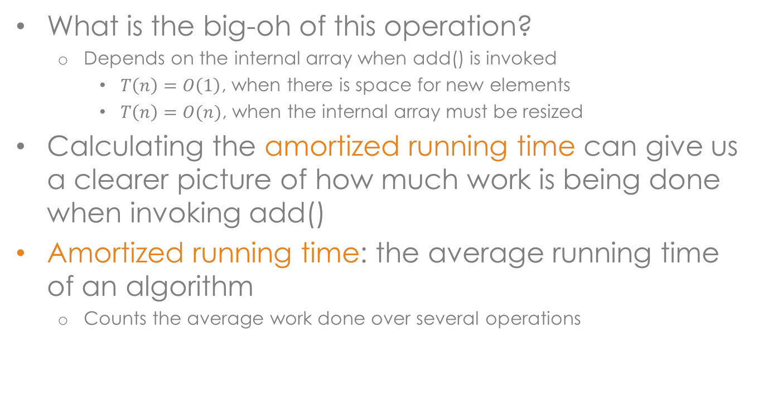
ArrayList.add()
What is the big-oh of this operation?
Depends on the internal array when add() is invoked
$T\left(n\right)=O\left(1\right)$, when there is space for new elements
$T\left(n\right)=O(n)$, when the internal array must be resized
Calculating the amortized running time can give us a clearer picture of how much work is being done when invoking add()
Amortized running time: the average running time of an algorithm
Counts the average work done over several operations

Slide 14
Amortized running time
How much work is done given the following scenario
Cost model: array assignments
Scenario
The array list has an internal array initially of length 5
The array list is empty
You add 6 elements to the array list
Steps
The first five elements are assigned to the internal array (five operations)
The internal array must be resized, so we copy over five elements from old array to new array (five operations)
The sixth element is added to the internal array (one operation)
Total operations: 11

Slide 15

Observations
The resize() operation is costly, whereas add() is not costly given available space
General principle
Given an internal array length of n
We can add n elements where each invocation of add() costs one operation
We then have an add() operation that costs n operations
The total work done over n + 1 additions is roughly 2n operations
The average operations per add() invocation is two operations and thus is O(1)

Slide 16
Observations
Key observation
We have long periods of little work
We then have a sharp increase in the amount of work
The average work done is actually still small
resize operations
ArrayList.add()
is O(1)
Periods of little work.
add() is invoked with
available space

Slide 17
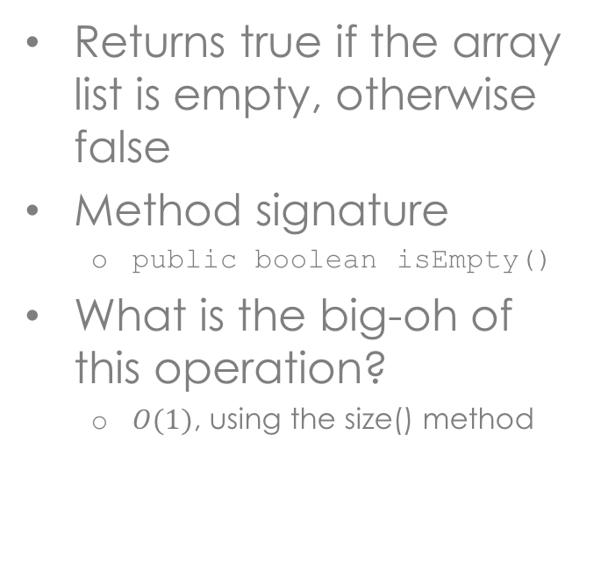
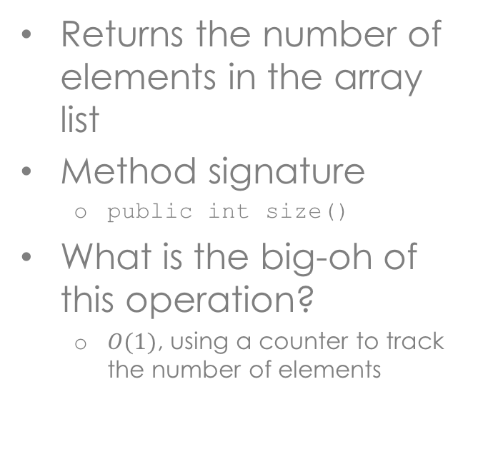
ArrayList element count
ArrayList.size()
ArrayList.isEmpty()
Returns the number of elements in the array list
Method signature
public int size()
What is the big-oh of this operation?
$O(1)$, using a counter to track the number of elements
Returns true if the array list is empty, otherwise false
Method signature
public boolean isEmpty()
What is the big-oh of this operation?
$O(1)$, using the size() method

Slide 18
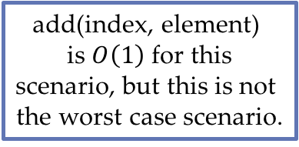
ArrayList.add(index, element)
Adds a new element at the given index
Method signature
public boolean add(int index, T element)
Scenario #1:
add() is invoked at index == size()
The new element is added to the next available index
add(5, F)
A | B | C | D | E
0 | 1 | 2 | 3 | 4
add(index, element)
is $O\left(1\right)$ for this
scenario, but this is not
the worst case scenario.

Slide 19
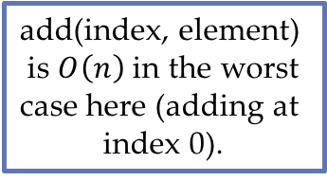
ArrayList.add(index, element)
Scenario #2:
add() is invoked on an occupied index
All elements from that position to size() – 1 are shifted up one position
add(D)
shift up one index
add(index, element)
is $O\left(n\right)$ in the worst
case here (adding at
index 0).
Before
A | B | C
0 | 1 | 2 | 3 | 4
After
A | D | B | C
0 | 1 | 2 | 3 | 4

Slide 20
ArrayList.remove(element)
Removes the first occurrence of the given element from the array list
Method signature
public boolean remove(T element)
Step #1
Sequentially scan the internal array using equals() to determine if the input is found
equals()
9 | 17 | 3 | -10 | 9 | 11 | 33 | 2
0 | 1 | 2 | 3 | 4 | 5 | 6 | 7

Slide 21
ArrayList.remove(element)
Step #2
Remove the element if present
This shifts all elements at higher indices to fill the gap
add(B)
shift down one
index
Before
A | B | C | D
0 | 1 | 2 | 3 | 4
After
A | C | D
0 | 1 | 2 | 3 | 4

Slide 22

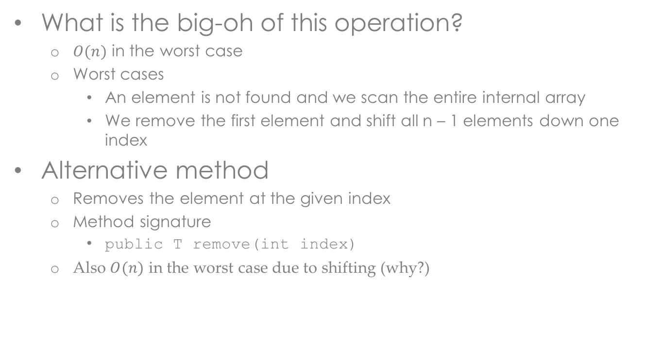
ArrayList.remove(element)
What is the big-oh of this operation?
$O(n)$ in the worst case
Worst cases
An element is not found and we scan the entire internal array
We remove the first element and shift all n – 1 elements down one index
Alternative method
Removes the element at the given index
Method signature
public T remove(int index)
Also $O(n)$ in the worst case due to shifting (why?)

Slide 23
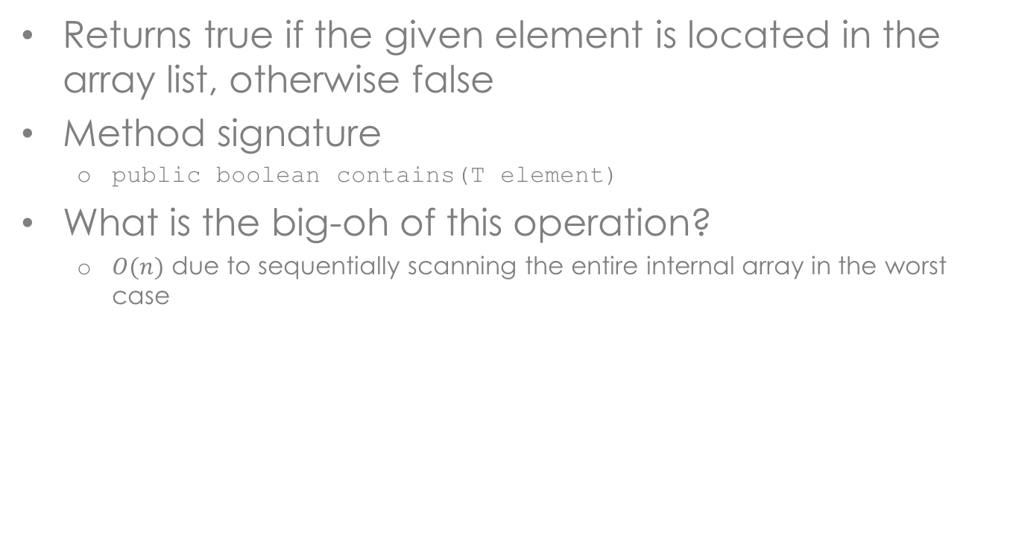
ArrayList.contains(element)
Returns true if the given element is located in the array list, otherwise false
Method signature
public boolean contains(T element)
What is the big-oh of this operation?
$O(n)$ due to sequentially scanning the entire internal array in the worst case

Slide 24
Linked Lists
Basic Data Structure Analysis

Slide 26
Stacks & Queues
Basic Data Structure Analysis

Slide 28
Sources

Slide 29
Data Structures & Algorithm Analysis
Introduction

